Slide 1

Session 1: Coding Basics

Slide 2
Session 1: Coding Basics
Outline
File System
Git and GitHub
Docker
Python vs R
IDEs

Slide 3
Session 1: Coding Basics
Outline
File System
Git and GitHub
Docker
Python vs R
IDEs

Slide 4
The File System
The file system defines how files are named, stored, and retrieved from a storage device (like your computer!).

Slide 5
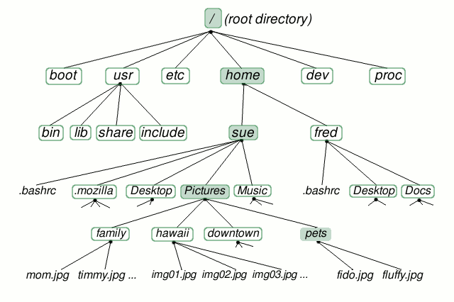
The File System
The file system defines how files are named, stored, and retrieved from a storage device (like your computer!).

Slide 6
The File System
The file system defines how files are named, stored, and retrieved from a storage device (like your computer!).
The root
Always at the top of the tree

Slide 7
The File System
The file system defines how files are named, stored, and retrieved from a storage device (like your computer!).
The root
Always at the top of the tree
Represented by a forward slash (`/`)

Slide 8
The File System
The file system defines how files are named, stored, and retrieved from a storage device (like your computer!).
The root
Always at the top of the tree
Represented by a forward slash (`/`)
All directories and files on a storage device are descendants of the root!

Slide 9
The File System
The file system defines how files are named, stored, and retrieved from a storage device (like your computer!).
Directories
Branching points in the file system (think folders!)

Slide 10
The File System
The file system defines how files are named, stored, and retrieved from a storage device (like your computer!).
Directories
Branching points in the file system (think folders!)
Used to organize files

Slide 11
The File System
The file system defines how files are named, stored, and retrieved from a storage device (like your computer!).
Files
How computers store information

Slide 12
The File System
The file system defines how files are named, stored, and retrieved from a storage device (like your computer!).
Files
How computers store information
Always located inside a directory

Slide 13
The File System
The file system defines how files are named, stored, and retrieved from a storage device (like your computer!).
Files
How computers store information
Always located inside a directory
Cannot contain other files

Slide 14
The File System
The file system defines how files are named, stored, and retrieved from a storage device (like your computer!).

Slide 15

The File System
The file system defines how files are named, stored, and retrieved from a storage device (like your computer!).

Slide 16
The File System
The file system defines how files are named, stored, and retrieved from a storage device (like your computer!).

Slide 17
The File System
The file system defines how files are named, stored, and retrieved from a storage device (like your computer!).

Slide 18
The File System
The file system defines how files are named, stored, and retrieved from a storage device (like your computer!).

Slide 19
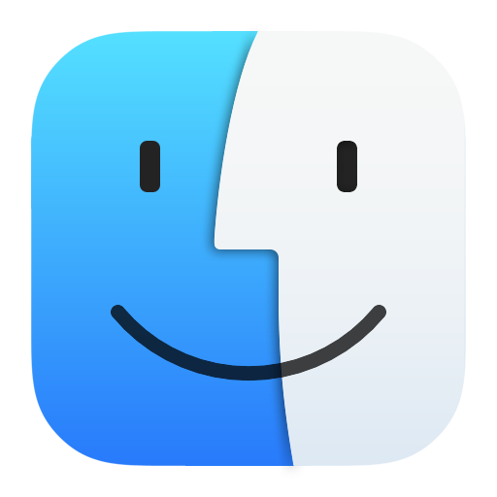

Navigating the File System
A lot of people interact with their computer using a GUI (graphical user interface), which is a visual representation of communication between you and your computer.

Slide 20
Navigating the File System
A lot of people interact with their computer using a GUI (graphical user interface), which is a visual representation of communication between you and your computer.
But this isn’t the only way…

Slide 21
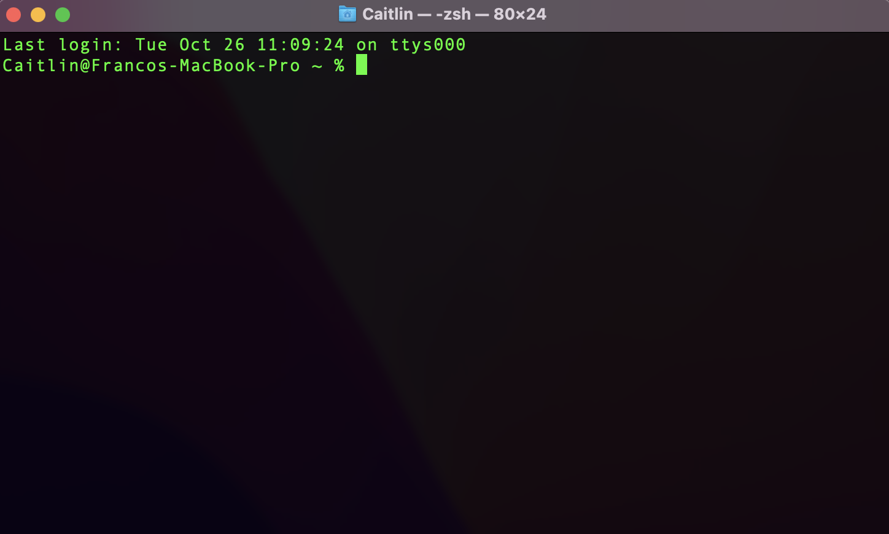
The Terminal
The terminal is an interface that lets you access the command line and accepts text input from you and uses that input to tell the computer to do stuff.

Slide 22
Why should you use the terminal?
The terminal is generally faster and more flexible than a GUI, and a lot of pretty cool bioinformatics packages and programs require some terminal know-how.

Slide 23
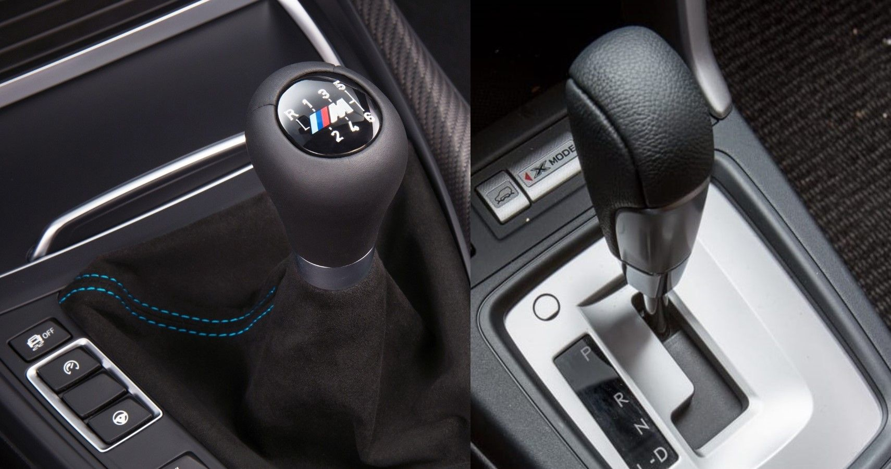
Why should you use the terminal?
The terminal is generally faster and more flexible than a GUI, and a lot of pretty cool bioinformatics packages and programs require some terminal know-how.

Slide 24
Why should you use the terminal?
The terminal is generally faster and more flexible than a GUI, and a lot of pretty cool bioinformatics packages and programs require some terminal know-how.

Slide 25
Path Names
A path name is the location for a file in the file system. Kind of like a GPS coordinate, the path name tells your computer where to find a specific file.

Slide 26
Path Names
A path name is the location for a file in the file system. Kind of like a GPS coordinate, the path name tells your computer where to find a specific file.

Slide 27
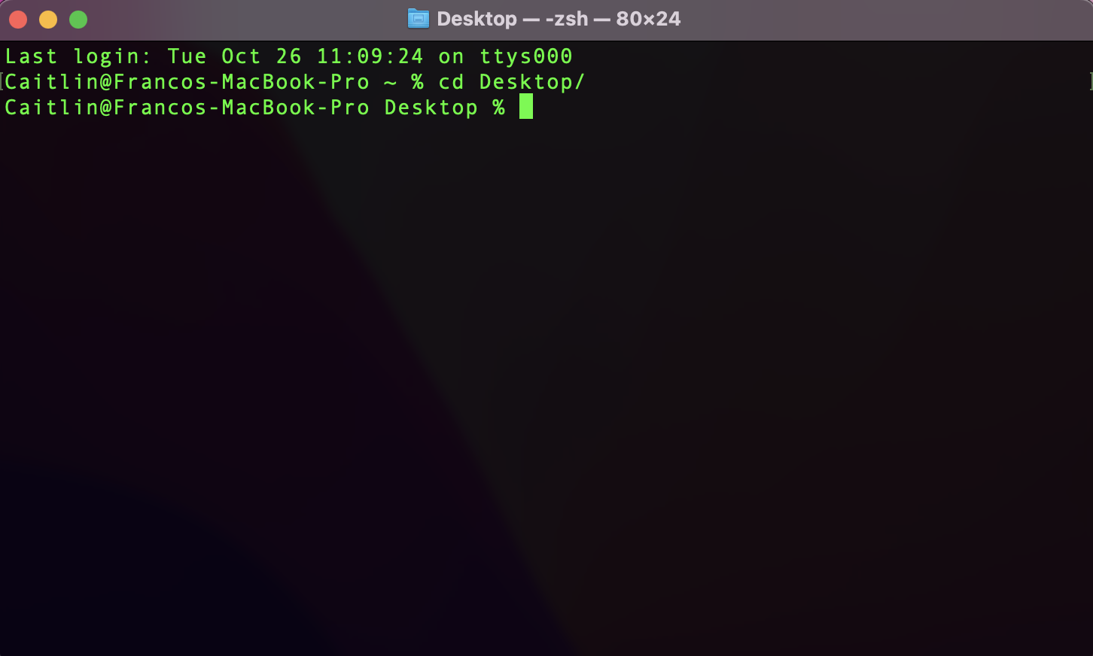
Path Names
A path name is the location for a file in the file system. Kind of like a GPS coordinate, the path name tells your computer where to find a specific file.
cd – change directory; change your location in a file system

Slide 28
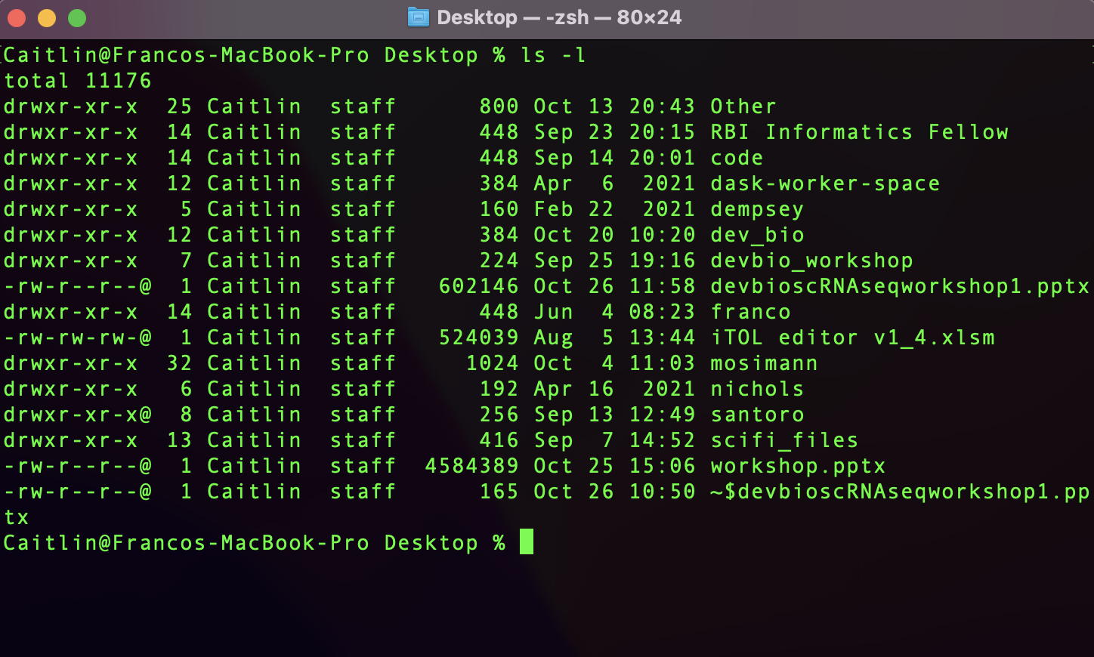
Path Names
A path name is the location for a file in the file system. Kind of like a GPS coordinate, the path name tells your computer where to find a specific file.
ls – list; check the contents (or files) of a directory

Slide 29
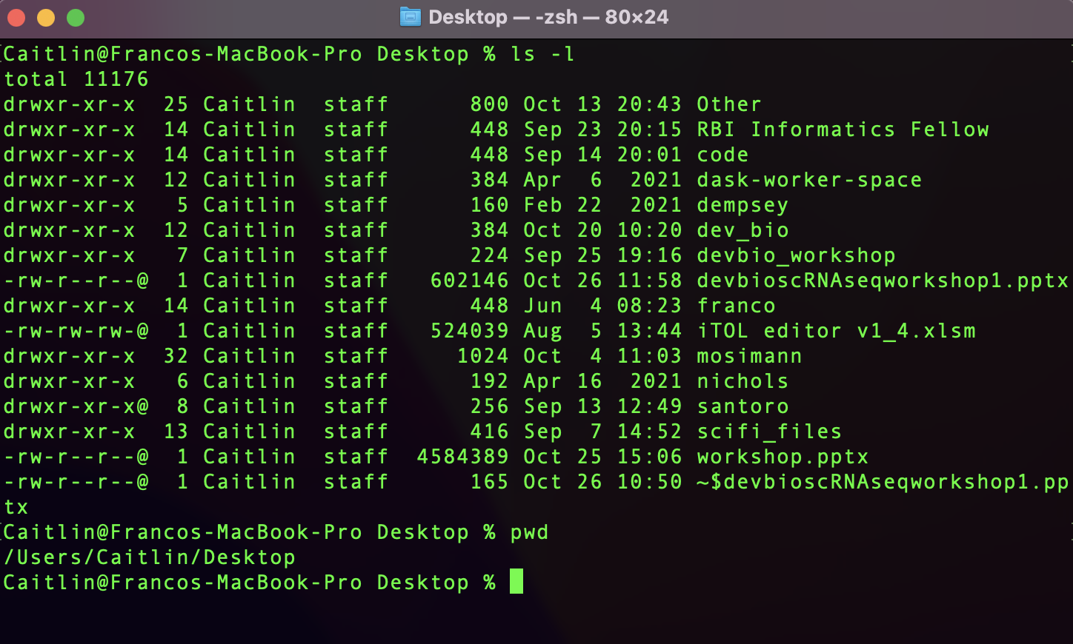
Path Names
A path name is the location for a file in the file system. Kind of like a GPS coordinate, the path name tells your computer where to find a specific file.
pwd – print working directory; your current location

Slide 30
Path Names
A path name is the location for a file in the file system. Kind of like a GPS coordinate, the path name tells your computer where to find a specific file.
This is an absolute path.

Slide 31
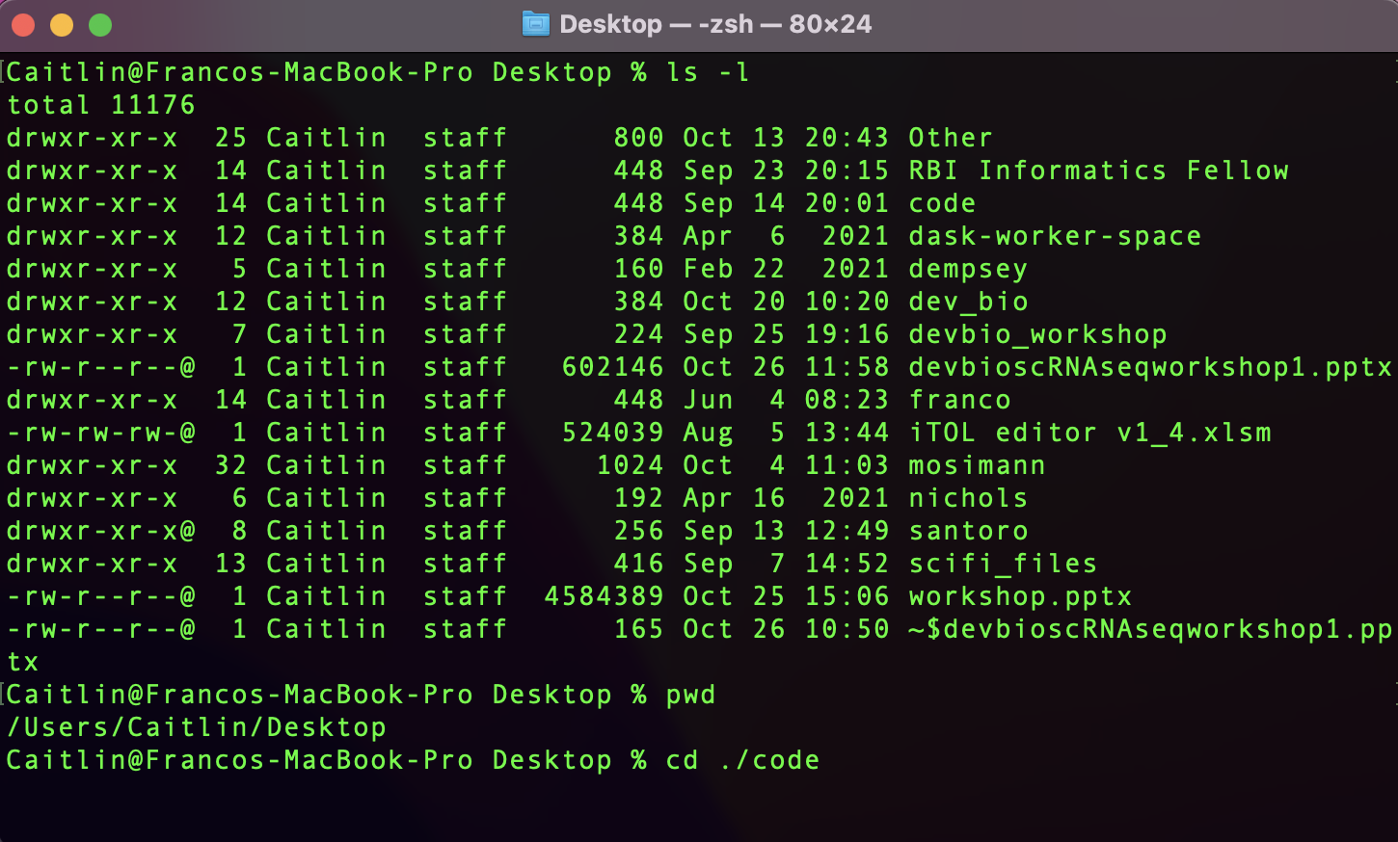
Path Names
A path name is the location for a file in the file system. Kind of like a GPS coordinate, the path name tells your computer where to find a specific file.
This is a relative path.

Slide 32
Let’s Practice!

Slide 33
Session 1: Coding Basics
Outline
File System
Git and GitHub
Docker
Python vs R
IDEs

Slide 34
Session 1: Coding Basics
Outline
File System
Git and GitHub
Docker
Python vs R
IDEs

Slide 35
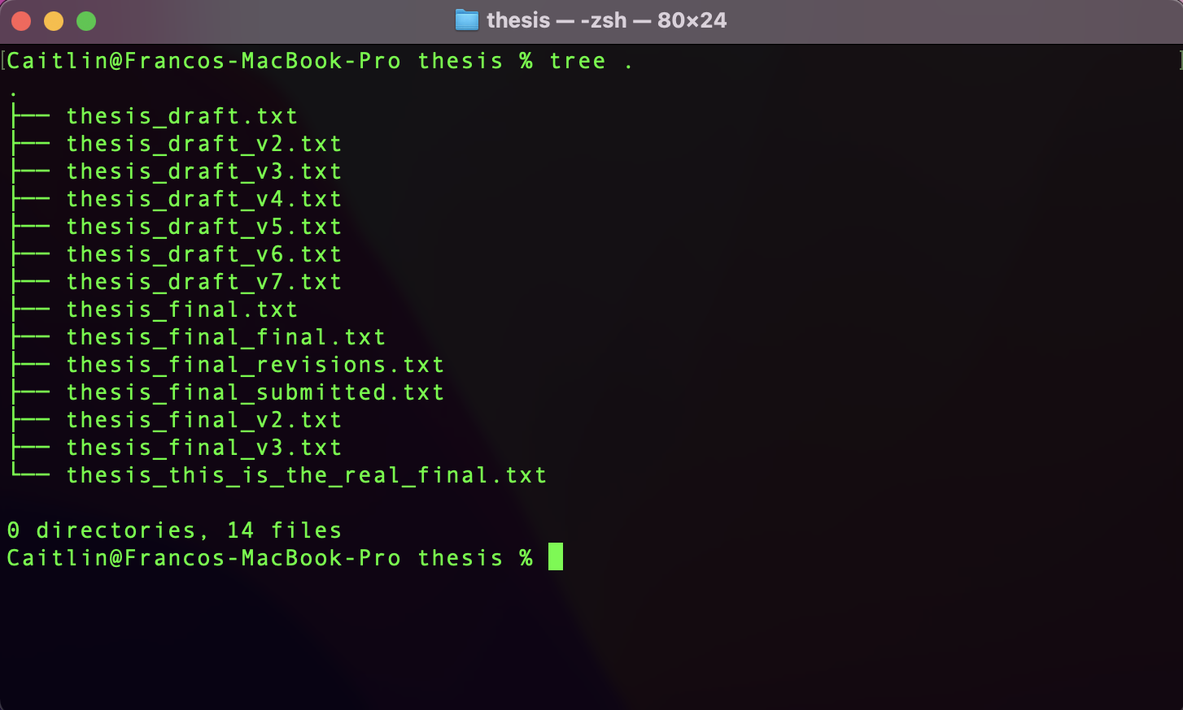
Version Example

Slide 36

Git and GitHub
Git is an open-source distributed version control system that helps software developers manage changes to source code over time.

Slide 37
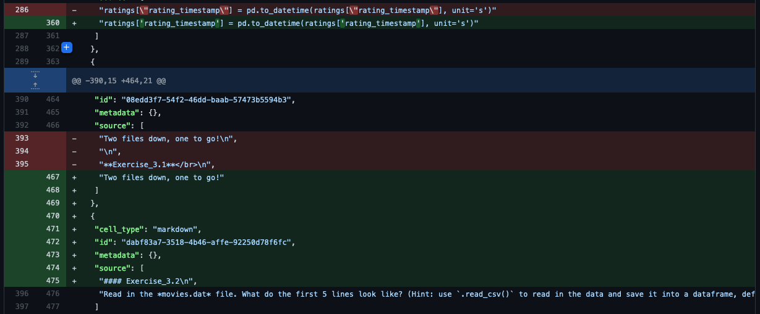
Git and GitHub
Git is an open-source distributed version control system that helps software developers manage changes to source code over time.

Slide 38

Git and GitHub

Slide 39
Git and GitHub
thesis_draft.txt

Slide 40
Git and GitHub
thesis_draft.txt
thesis_draft_v2.txt

Slide 41
Git and GitHub
thesis_draft.txt
thesis_draft_v2.txt
thesis_draft_v3.txt

Slide 42
Git and GitHub
thesis_draft.txt
thesis_draft_v4.txt
thesis_draft_v2.txt
thesis_draft_v3.txt

Slide 43
Git and GitHub
thesis_draft.txt
thesis_draft_v4.txt
thesis_final.txt
thesis_draft_v2.txt
thesis_draft_v3.txt

Slide 44
Git and GitHub

Slide 45
Git and GitHub

Slide 46
Git and GitHub
This is our main branch.

Slide 47
Git and GitHub
This is a clone.

Slide 48
Git and GitHub
This is a good change that was merged back in.

Slide 49
Let’s Practice!

Slide 50
Session 1: Coding Basics
Outline
File System
Git and GitHub
Docker
Python vs R
IDEs

Slide 51
Session 1: Coding Basics
Outline
File System
Git and GitHub
Docker
Python vs R
IDEs

Slide 52

Docker
Docker is an open-source containerization platform. Containerization is when we package a bunch of software together into an isolated, self-sufficient container.

Slide 53
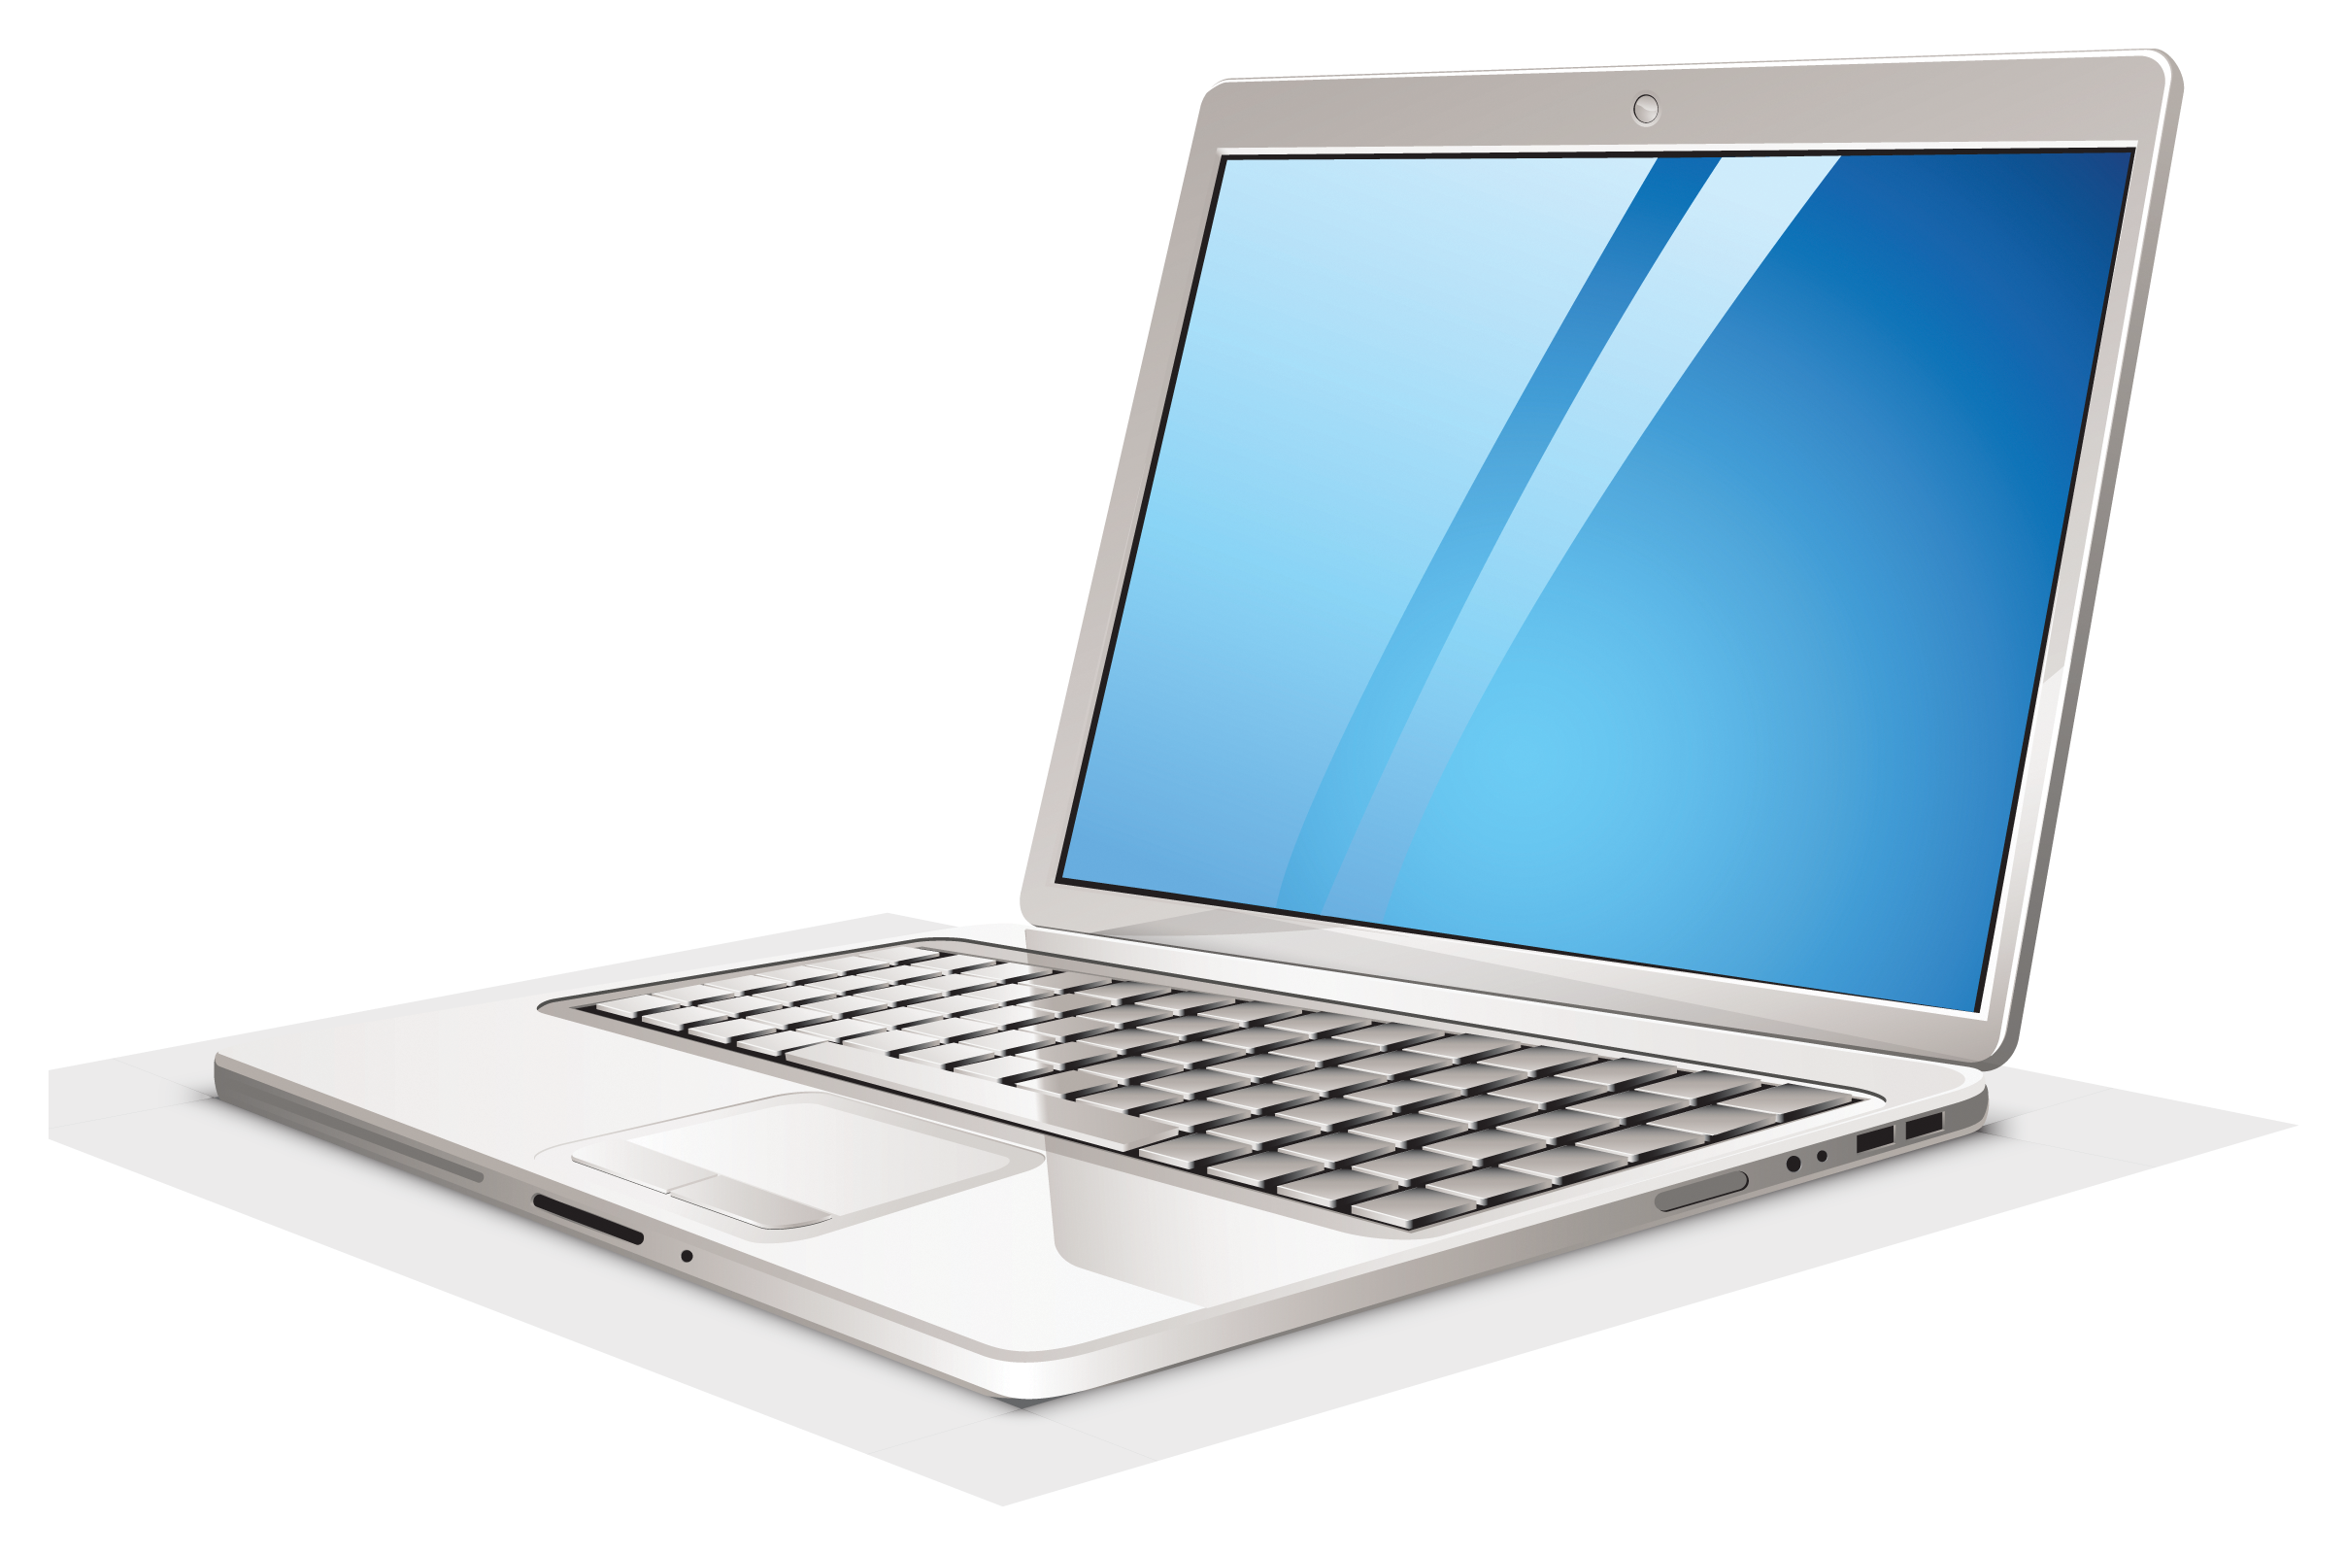

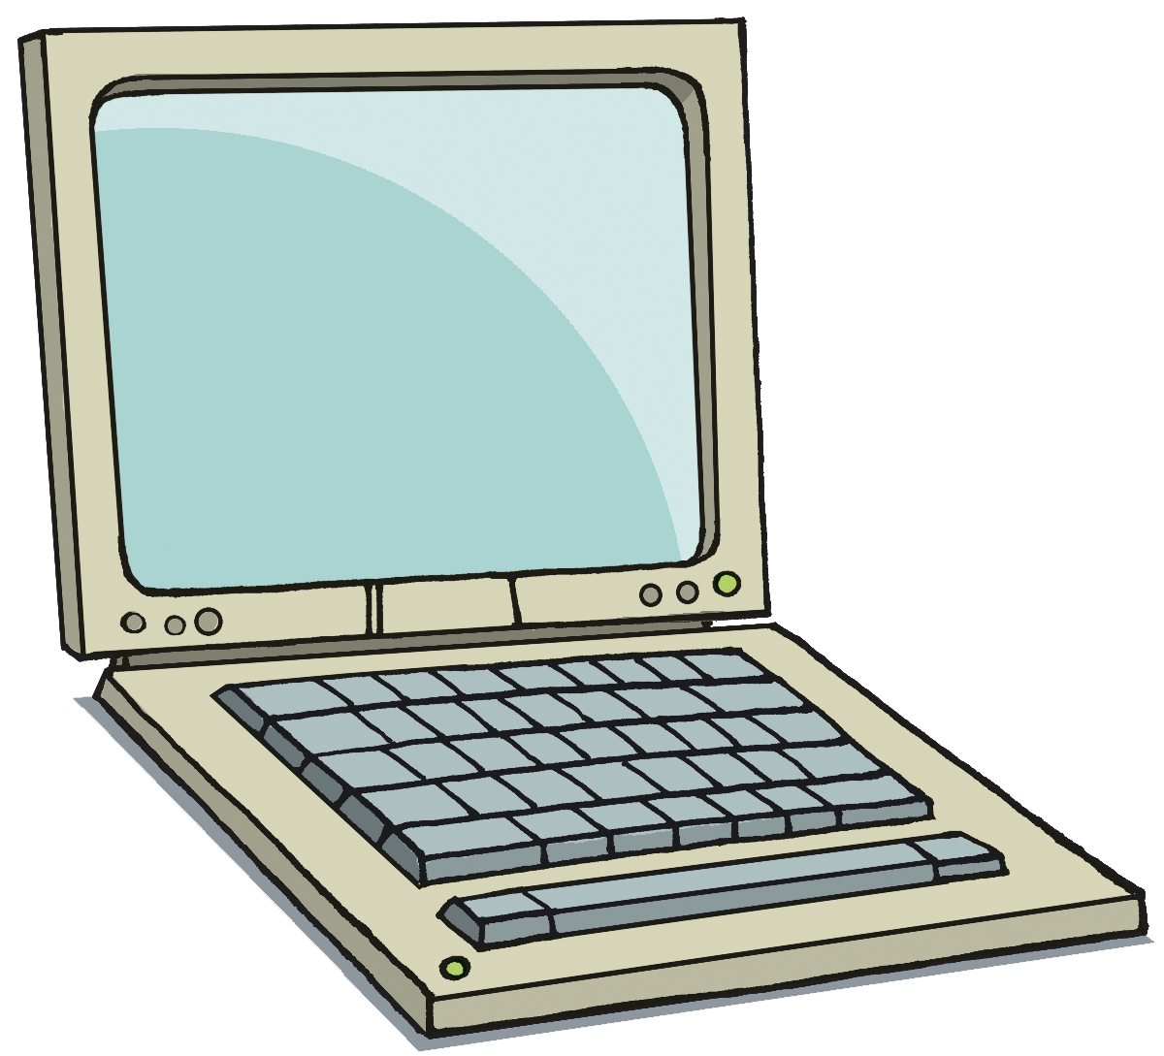
Docker
Docker is an open-source containerization platform. Containerization is when we package a bunch of software together into an isolated, self-sufficient container.

Slide 54
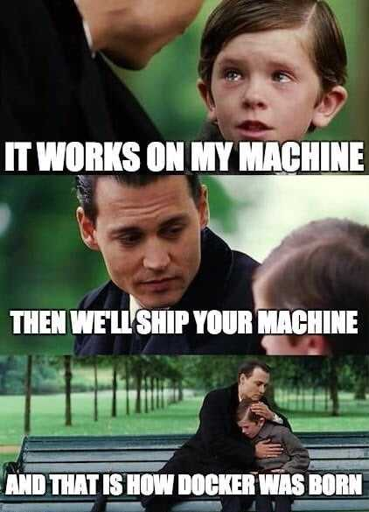
Docker
Docker is an open-source containerization platform. Containerization is when we package a bunch of software together into an isolated, self-sufficient container.

Slide 55
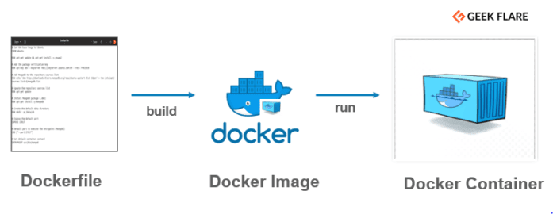
Docker
Docker is an open-source containerization platform. Containerization is when we package a bunch of software together into an isolated, self-sufficient container.

Slide 56
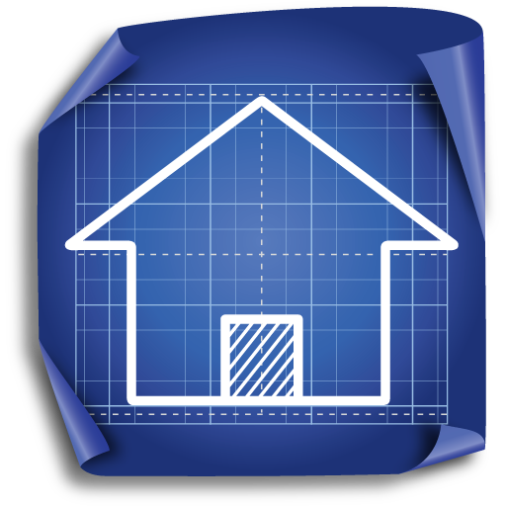
Docker
Docker is an open-source containerization platform. Containerization is when we package a bunch of software together into an isolated, self-sufficient container.

Slide 57

Docker
Docker is an open-source containerization platform. Containerization is when we package a bunch of software together into an isolated, self-sufficient container.

Slide 58

Docker
Docker is an open-source containerization platform. Containerization is when we package a bunch of software together into an isolated, self-sufficient container.

Slide 59
Docker
Docker is an open-source containerization platform. Containerization is when we package a bunch of software together into an isolated, self-sufficient container.

Slide 60
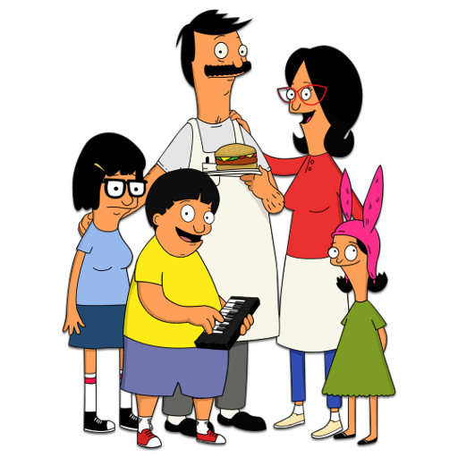
Docker
Docker is an open-source containerization platform. Containerization is when we package a bunch of software together into an isolated, self-sufficient container.

Slide 61
Session 1: Coding Basics
Outline
File System
Git and GitHub
Docker
Python vs R
IDEs

Slide 62
Session 1: Coding Basics
Outline
File System
Git and GitHub
Docker
Python vs R
IDEs

Slide 63

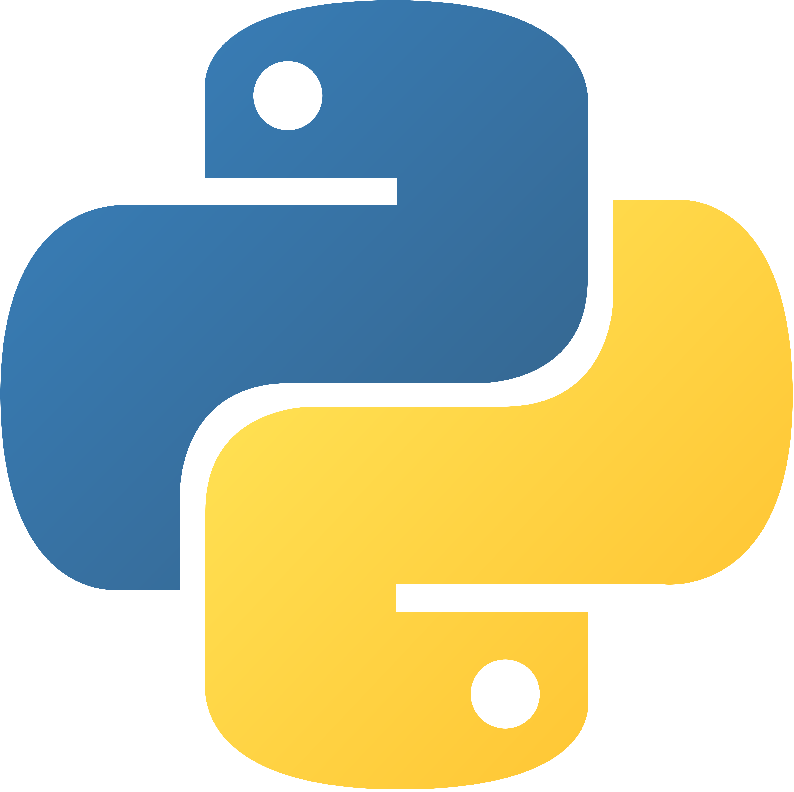


Slide 64
Bioinformaticians use both!
General-purpose programming language that emphasizes code readability
Released in 1989, it is currently the most popular programming language (TIOBE index)
Popular data science libraries include:
Numpy
Pandas
Matplotlib
IDE = Jupyter notebooks/lab
Optimized for statistical analysis and data visualization
Released in 1995, it is currently the 14th most popular programming language (TIOBE index)
Tons of libraries and tools for:
Cleaning and prepping data
Creating visualizations
Linear/nonlinear modeling
Statistical tests
IDE = RStudio

Slide 65
Session 1: Coding Basics
Outline
File System
Git and GitHub
Docker
Python vs R
IDEs

Slide 66
Session 1: Coding Basics
Outline
File System
Git and GitHub
Docker
Python vs R
IDEs

Slide 67


IDEs
An Integrated Development Environment (IDE) is software that gives users an environment to program, and includes developing, testing, and debugging tools.

Slide 68
Let’s check out our container!

